Slide 1
FLOW CHARTS FOR THE PROGRAMS
SATWIK SAI PRAKASH SAHOO

Slide 2
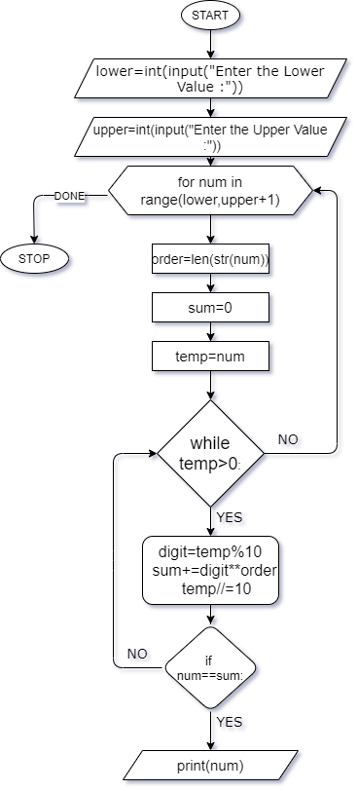
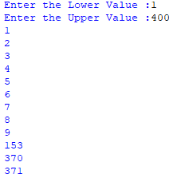
PROGRAM TO PRINT ARMSTRONG NUMBERS BETWEEN 2 NUMBERS.

Slide 3
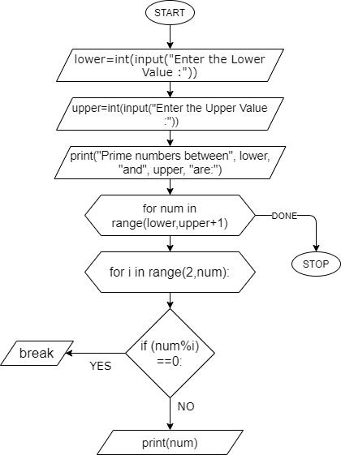
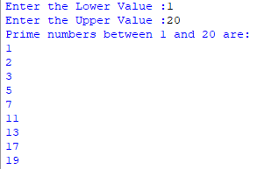
PROGRAM TO PRINT PRIME NUMBERS BETWEEN 2 NUMBERS.
BREAK

Slide 4
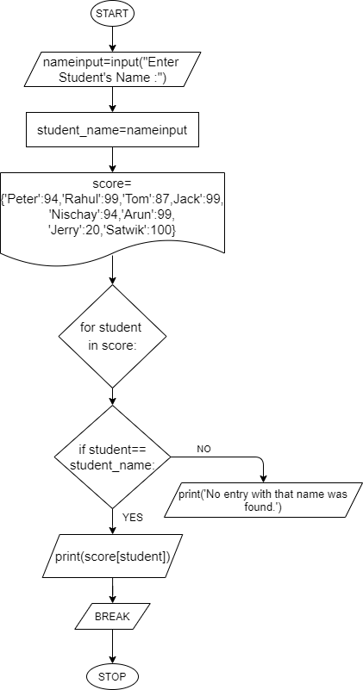


PROGRAM TO OBTAIN STUDENT’S MARKS .
BREAK

Slide 5
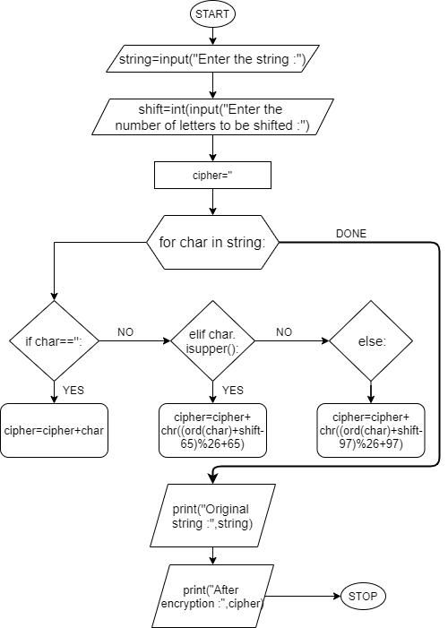

CAESAR CIPHER ENCRYPTION PROGRAM.

Slide 6


CAESAR CIPHER ENCRYPTION PROGRAM.

Slide 7
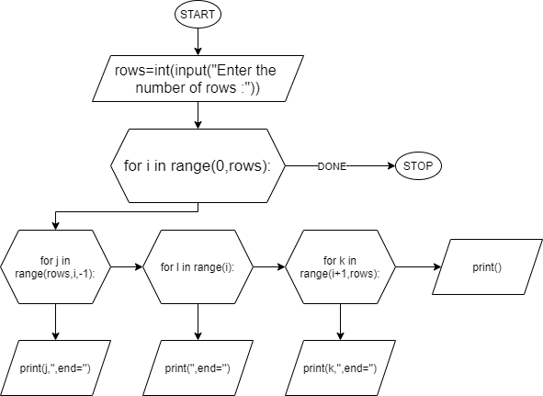
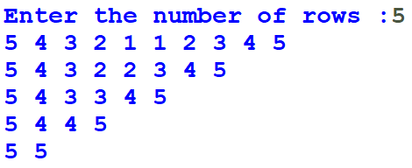
A PATTERN PROGRAM

